Slide 1
N^2 is sum of the first N odd numbers

Slide 2
The number N is a Square Number iff one can arrange N points in a square

Slide 3
Square Number has an odd number of factors
16
1
16
2
8
4

Slide 4
Composite Number (that is not square) has an even number of factors
10
1
10
2
5

Slide 5
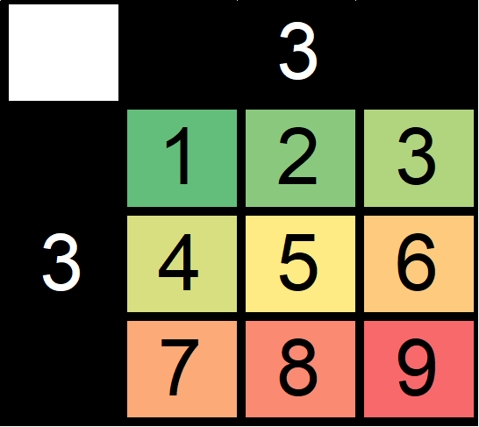
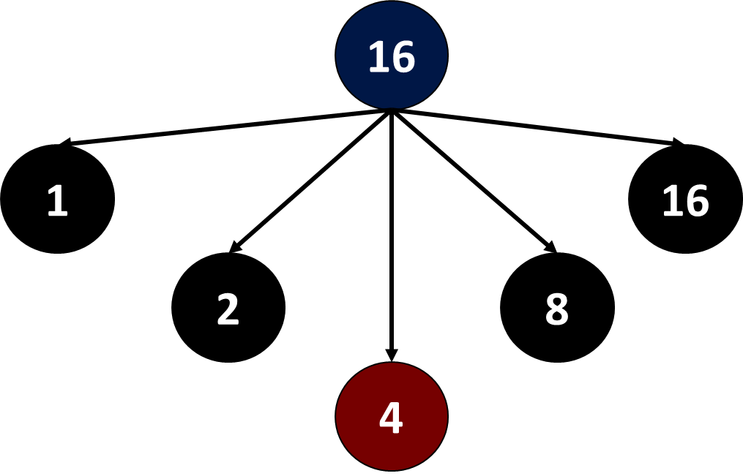
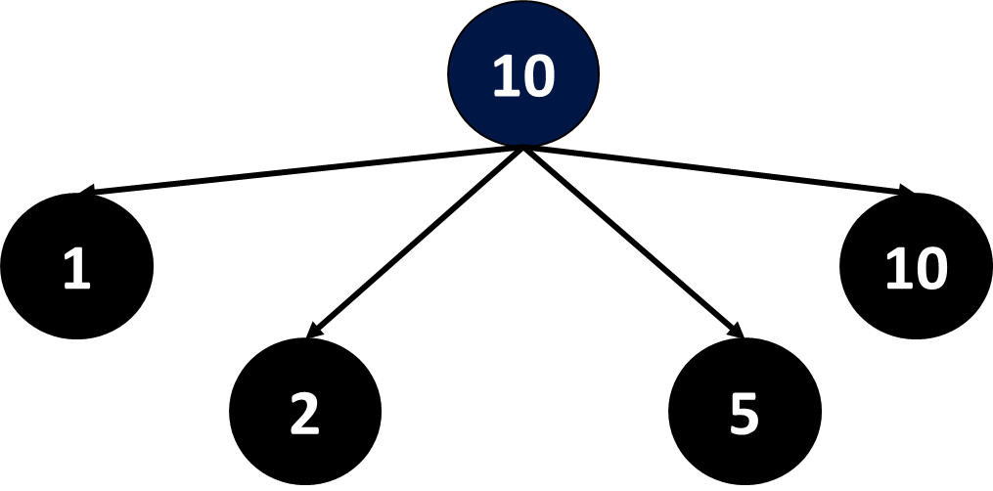
The number N is a Square Number iff one can arrange N points in a square
N^2 is sum of the first N odd numbers
Square Number has an odd number of factors
Composite Number (not square) has as even number of factors

Slide 6
The number N is a Square Number iff one can arrange N points in a [1]
N^2 is sum of the first N [2] numbers
Square Number has an [3] number of factors
Composite Number (not square) has an [4] number of factors

